Slide 1
Data Analysis with Marketing
Analytics of IFood
Renatha Vieira
Davi Santos
Data Analysis and Statistics
FCUP - 2024

Slide 2
Dataset understanding
This dataset was originally presented to potential data analysts as a trial dataset at iFood
is the largest food delivery business in Brazil and Latin America and one of Brazil major successful technology startups
The dataset includes more than 2,000 rows:
demographic attributes;
sales information;
the acceptance of six different marketing campaigns;
the amounts spent on different food and goods via delivery;
customer complaints;
24 variables
Numerical Discrete:
AcceptedCmpOverall;
Customer_Days
Kidhome
Teenhome
Income
MntFishProducts, MntMeatProducts, MntFruit, MntSweetProducts, MntWines, MntGoldProds, MntTotal, MntRegularProds;
NumDealsPurchases, NumCatalogPurchases, NumStorePurchases, NumWebPurchases;
NumWebVisitsMonth
Recency
Age
Categorical Nominal:
Marital Status;
Categorical Ordinal:
Education level;
Binary:
Complain;
Campaign 1-6

Slide 3
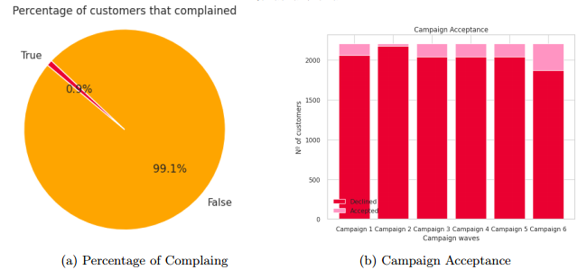
Univariate Analysis - Categorical Variables
1% of customers complained;
Low campaign acceptance
Campaign 2 higher rejection;
Campaign 6 higher acceptance;
Fig 1. Univariate Analysis of Consumer Behavior

Slide 4
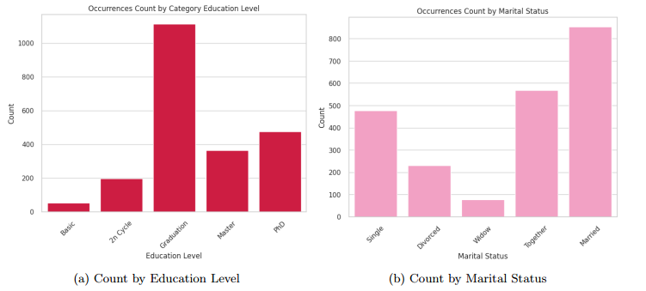
Univariate Analysis - Categorical Variables
The majority of customers have at least a Graduation;
Also the majority of customers are couples (together or married);
Fig 2. Univariate Analysis of Consumer’s Demographics Data

Slide 5
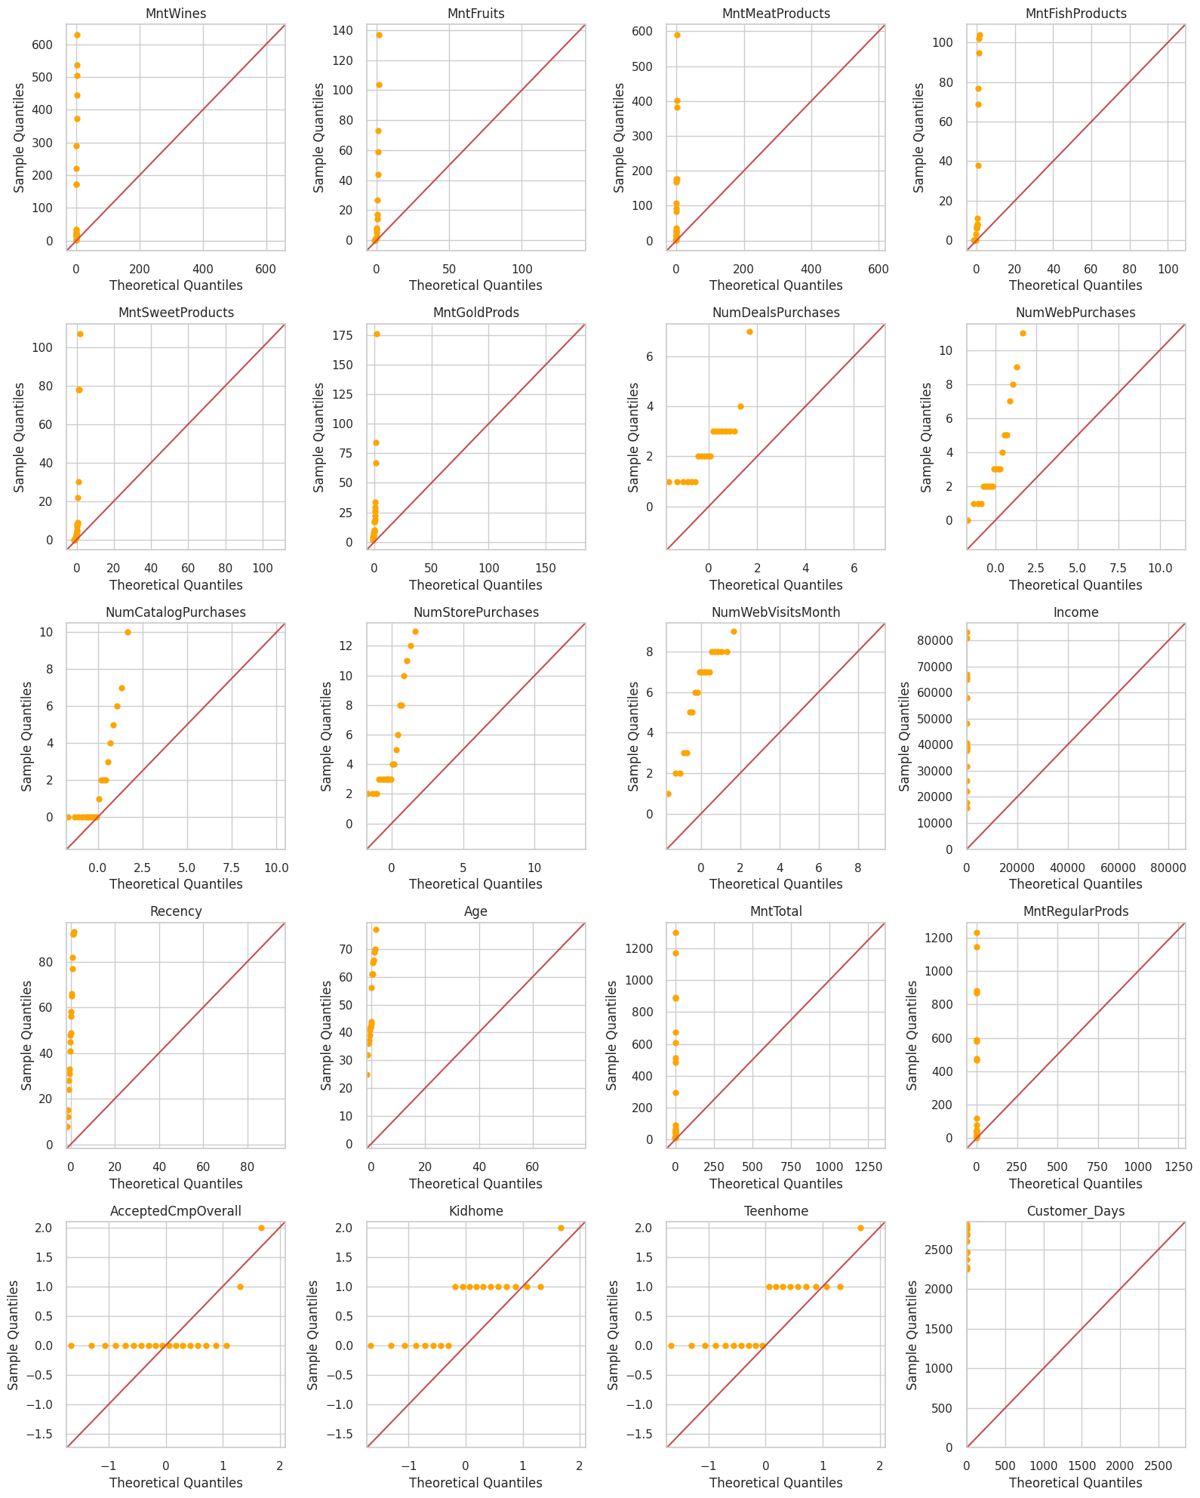
Univariate Analysis - Numerical Variables
Shapiro-Wilk tests were conducted for all variables: None of the variables follow a normal distribution
Fig 3. QQ-Plot with the reference to the diagonal of Normal
distribution
.

Slide 6
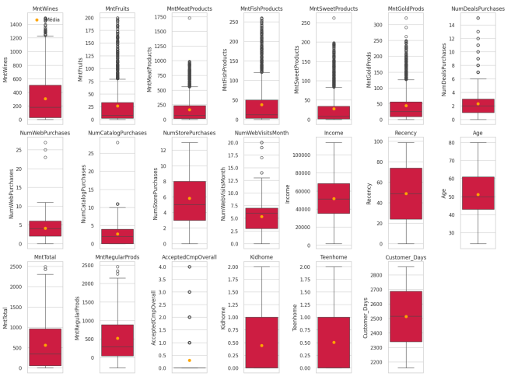
Univariate Analysis - Numerical Variables
High occurrence of outliers in the amount spent values.
Different customer profiles
Fig 4. Boxplots of numerical variables

Slide 7
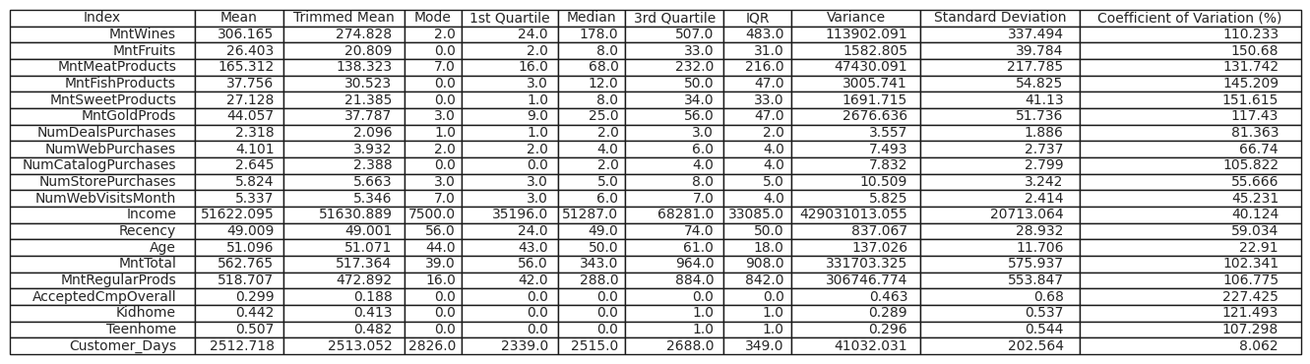
Univariate Analysis - Numerical Variables
Table 1. Summary statistics of numerical variables
Amount of products purchased: CV > 100% = high variation of amount of products purchase behaviour;
Monthly purchases by channels: Store is the most important purchase channel
The mean Age of customers is 51 years;
Kidhome/Teenhome: at least 50% of the customers don’t have kids

Slide 8
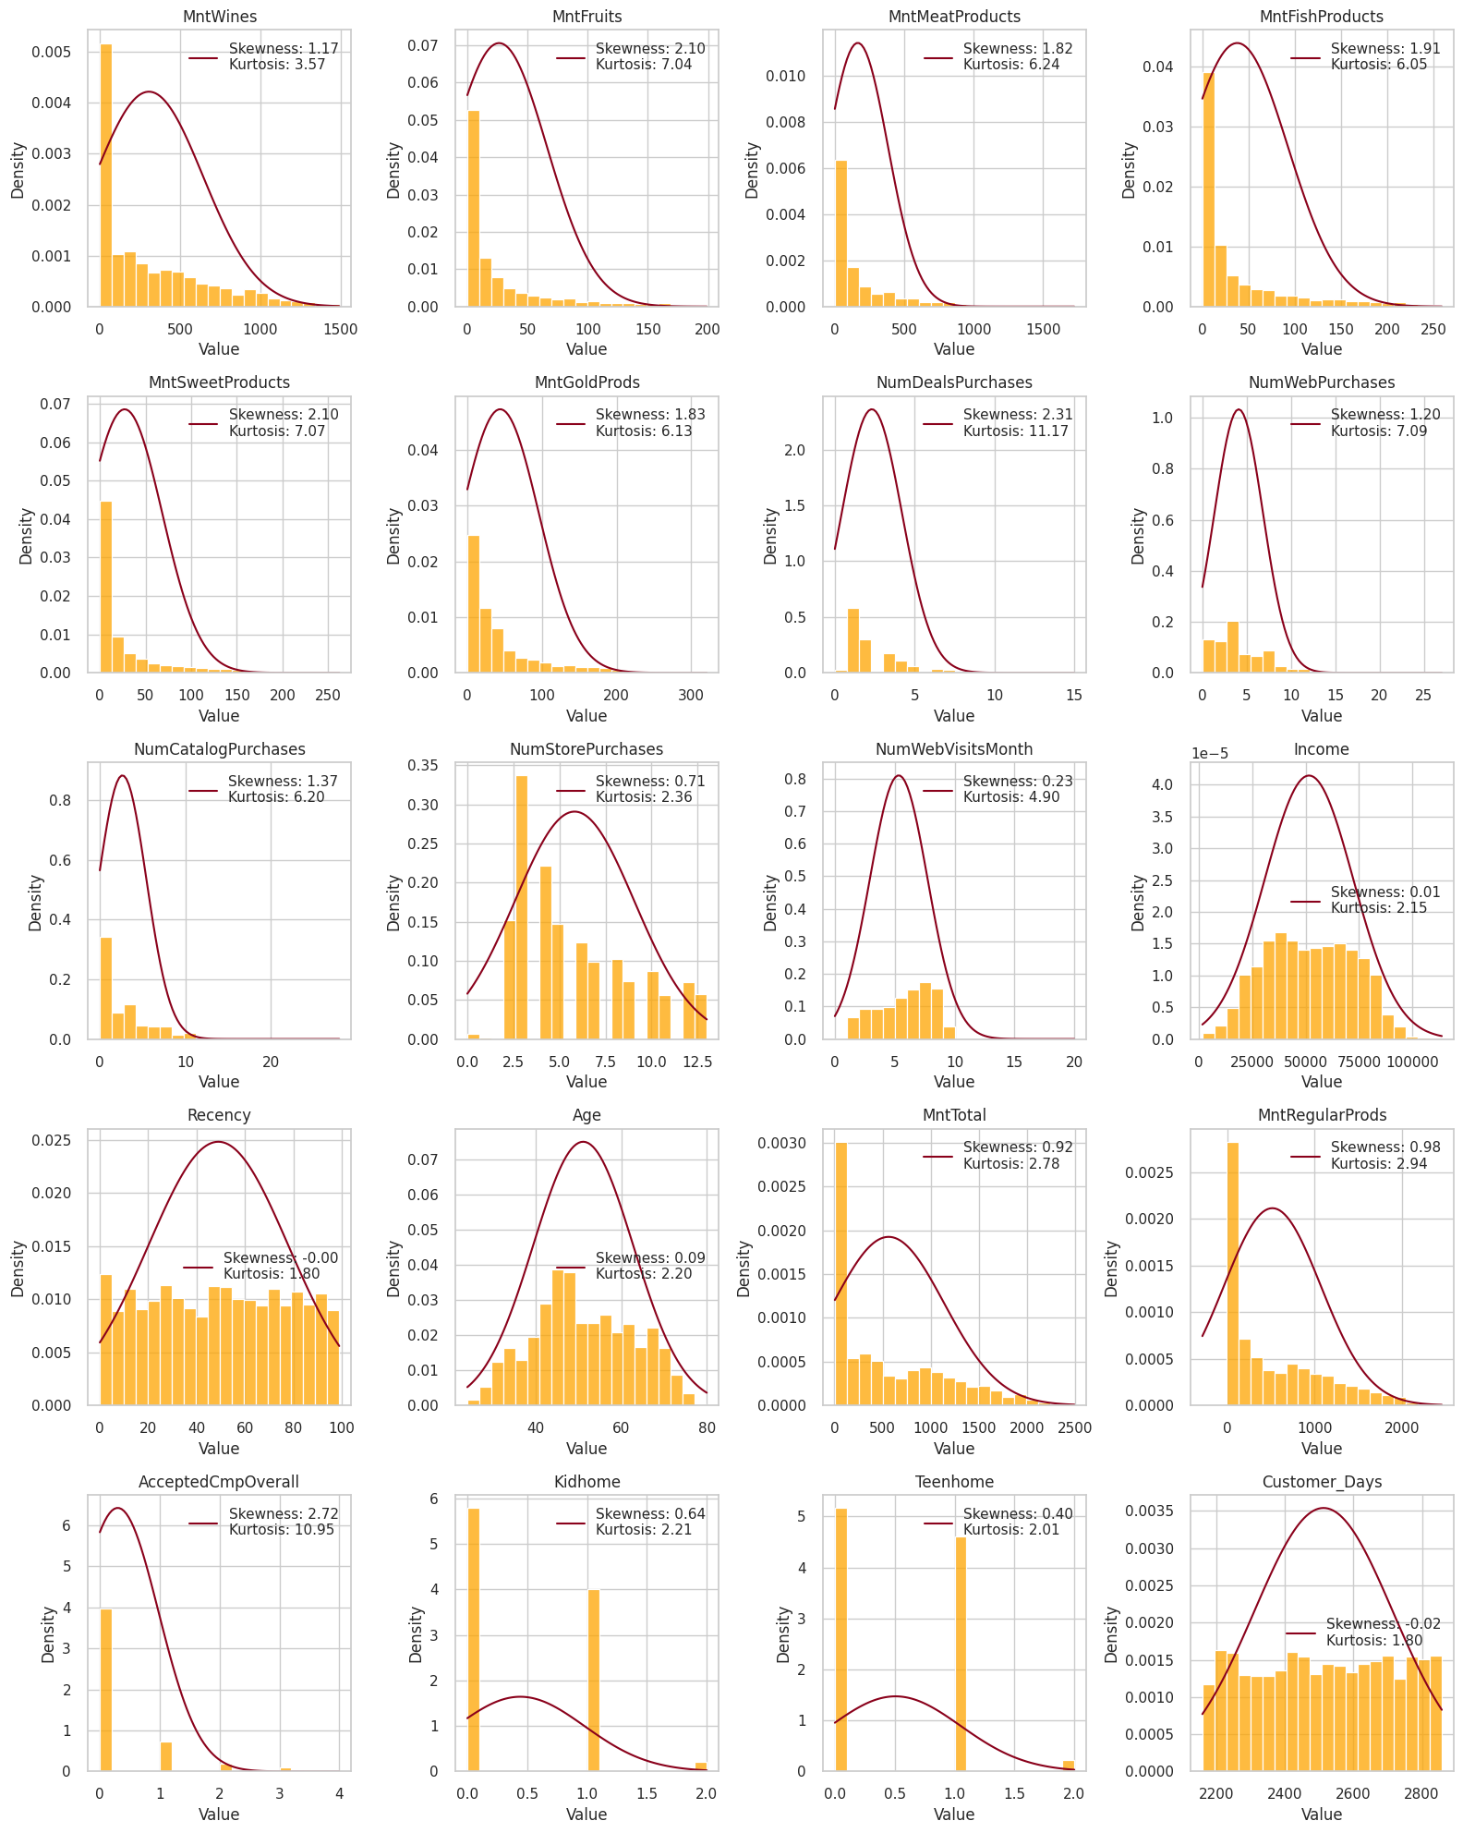
Univariate Analysis - Numerical Variables
Kurtosis and Skewness of numerical variables

Slide 9
Bivariate Analysis - Categorical x Categorical
The Chi-square independence test indicated association between the categories:
Campaign 6 acceptance:
Marital status: Single customers had higher acceptance;
Education level : Higher is the education level, higher was the campaign acceptance;
Campaign 4 acceptance:
Education level : Higher is the education level, higher was the campaign acceptance. Those customers with basic education, had almost total rejection.

Slide 10
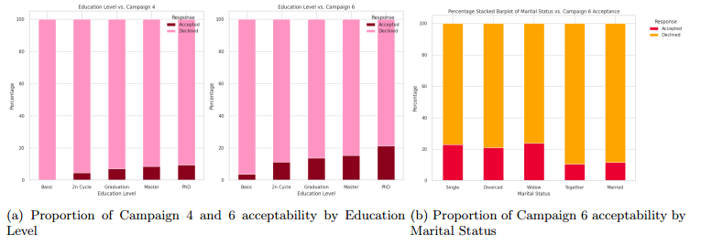
Bivariate Analysis - Categorical x Categorical
Fig 4. Proportion of Associated Categorical Variable

Slide 11
Bivariate Analysis - Numerical x Categorical (N classes)
Kruskal-Wallis test to conduct bivariate analysis between the level of education, marital status,
and the other numerical variables - non normality, 5 classes per variable.
Education level: statistically significant difference in the medians of these variables among different levels of education:
Amount spent in products;
Number of purchases done and the channels to do so;
Customer Days
Nº teen and kid at home

Slide 12
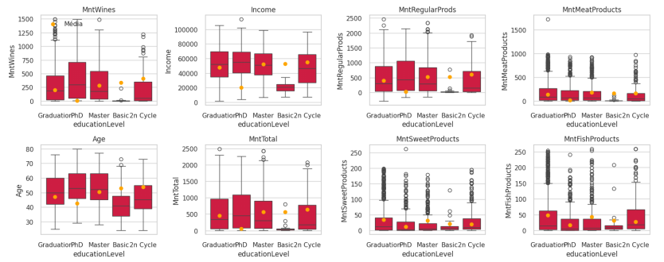
Bivariate Analysis - Numerical x Categorical (N classes)
Few examples:
Fig 5. Numerical Variables by Level of Education

Slide 13
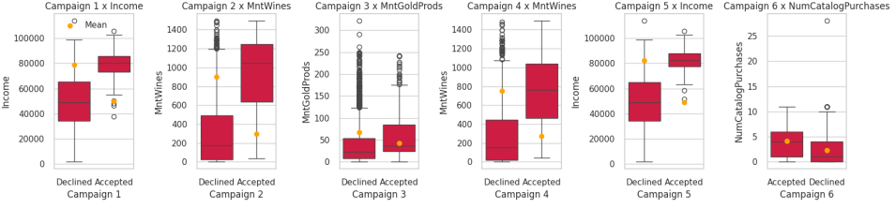
Bivariate Analysis - Numerical x Binary
We conducted the Mann-Whitney U test to analyze the relationship between our categorical binary variables and numerical data.
Market campaigns analysis: spotlight only the numerical variables that demonstrated the strongest association with each campaign.
Fig 6. Box-plot of Campaign acceptance versus the numerical variable with stronger association

Slide 14
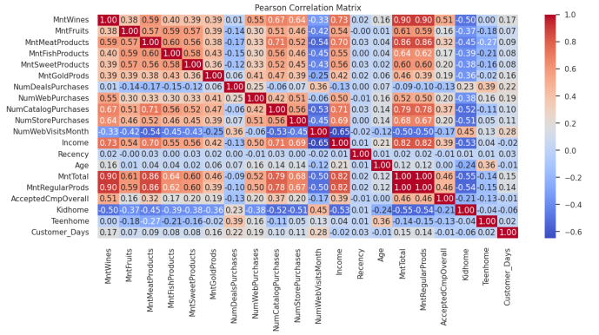
Bivariate Analysis - Numerical x Numerical
Pearson Correlation Matrix
+ Income:
+ Amount spent;
+ Campaign Acceptance
- Web visits;
- Kidhome;
- Purchase in Deals;
+ Kidhome:
- Amount spent;
+ Web visits;
+ Purchase in Deals;
Fig 7. Correlation Matrix

Slide 15
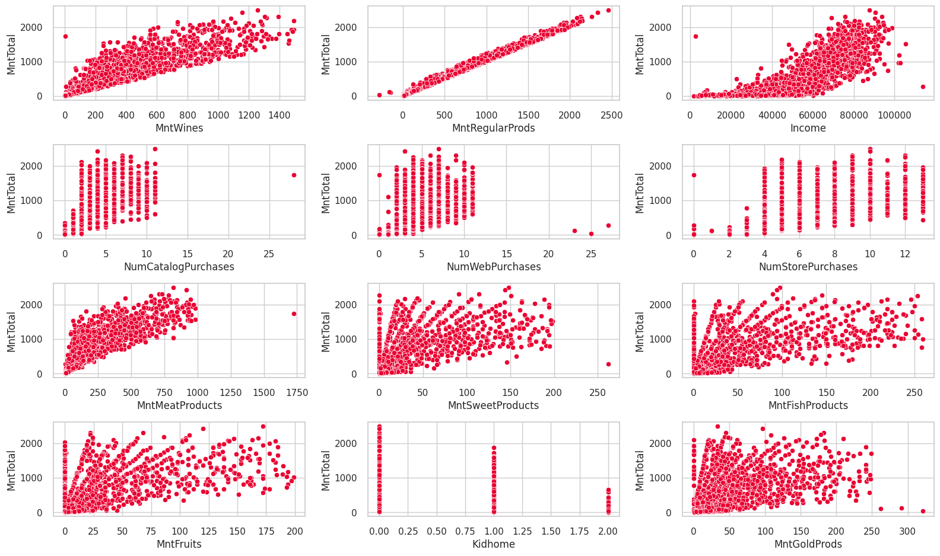
Bivariate Analysis - Numerical x Numerical
Fig 8. Scatter Plots of Relationships between Total Amount Spent and the Most Correlated Variables

Slide 16
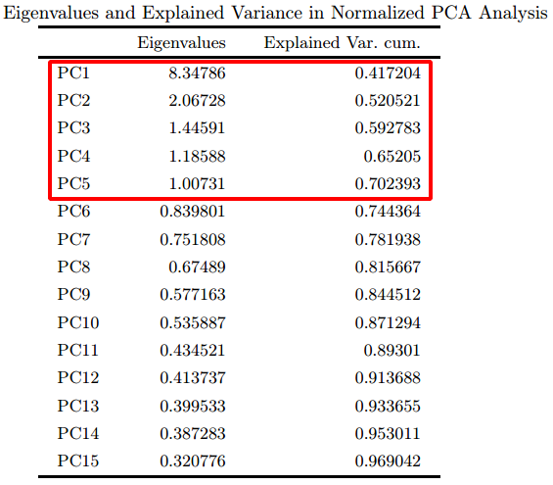
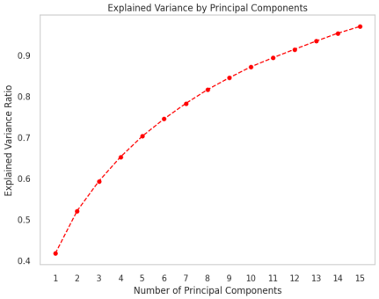
Multivariate Analysis - PCA
Significant correlations between the numerical variables;
From the total variance of 20 variables, the first 5 components explains 70,23% of variance.
Kaiser’s criterion ( eigenvalues > 1)
Pearson’s criterion (80% exp. variance)
Cattell’s criterion ( Elbow rule)
Fig. 9 Explained Variance and Principal Components.
Table 2. Principal components, eigenvalues and explained variance.

Slide 17
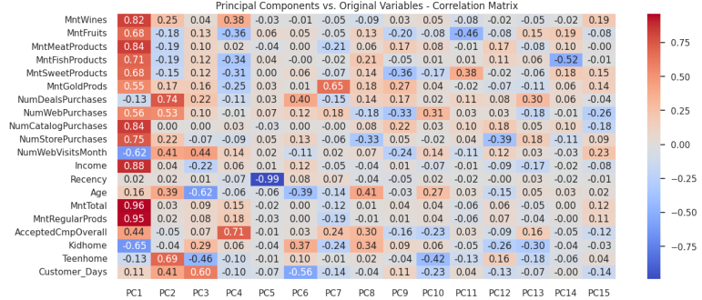
Multivariate Analysis - PCA
Fig. 10 Correlation matrix of Principal components and original variables.

Slide 18
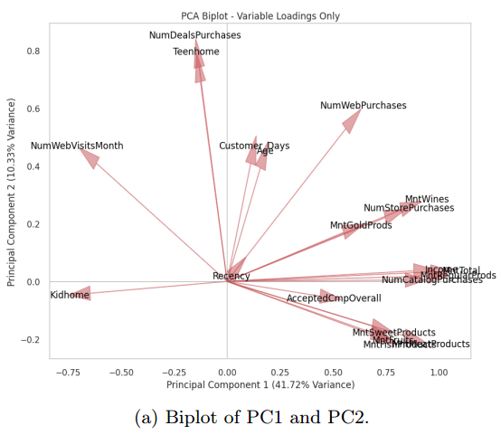
Multivariate Analysis - PCA
1st Principal Component:
Income;
Amount spent in the delivery platform;
Campaigns acceptance;
Kids at home;
Website visits;
⇒ Customers with more money, spend more and have higher campaign acceptance. Possibly they have less kids at home and does less visits to the platform website.
2nd Principal Component -
Teens at home;
The customers have mature age;
Customer Days;
Purchases in deals;
Usage of web platform;
⇒ Customers with higher age, have teens at home and possibly does more deal purchases.
Fig 11. Principal components 1 and 2

Slide 19
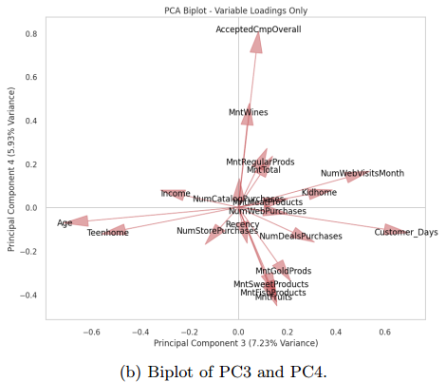
Multivariate Analysis - PCA
The 3rd Principal Component:
Customer Days;
NumWebVisitsMonth;
Kids at home;
Deal purchases;
Age and Teens at home;
⇒ Customers with kids at home does more visits to the website and purchases in deals. These customers are younger.
The 4th Principal Component:
Campaign acceptance;
Wine products;
Traditional products;
⇒ We can interpret that the campaign acceptance is correlated with the customer profile that spend money in wines. This contrast with those customers that spent on the other product types.
Fig 12. Principal components 3 and 4

Slide 20
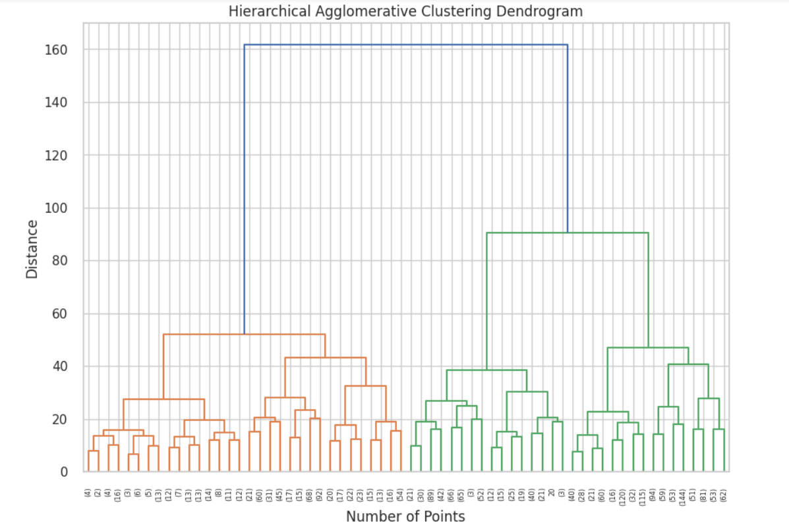
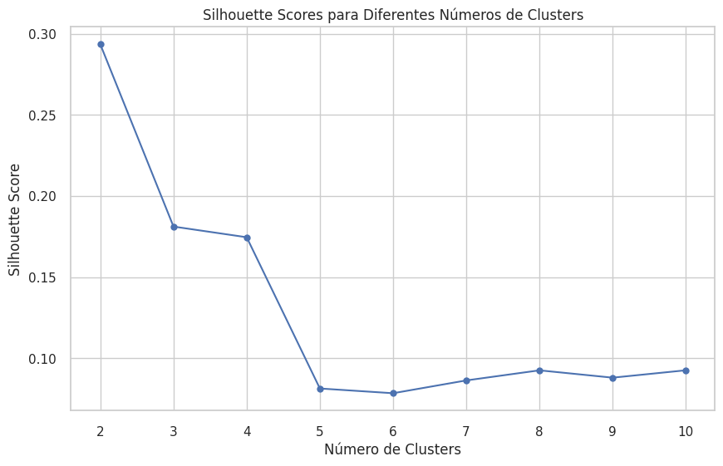
Multivariate Analysis - Clustering
Fig 14. Silhouette index - Cluster determination.
Fig 13, Agglomerative Hierarchical Clustering Dendrogram: Customer Segmentation Analysis

Slide 21
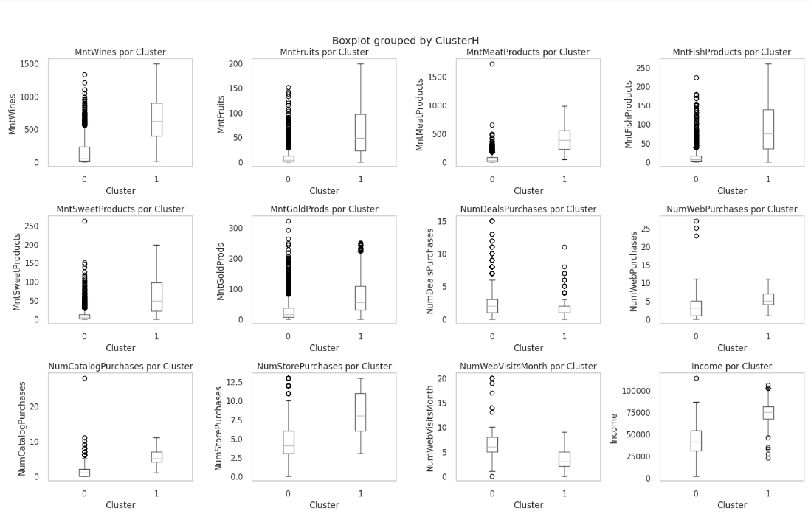
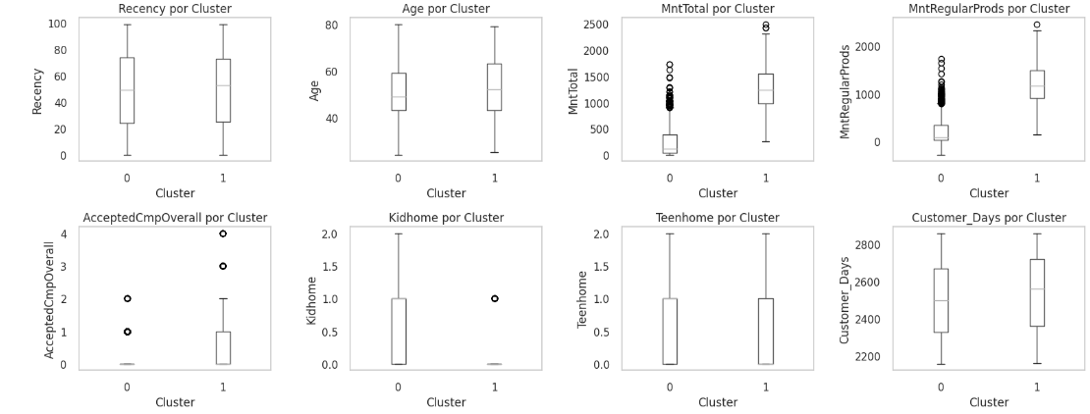
Multivariate Analysis - Clustering
Fig 15. Cluster-wise Distribution: Box Plots

Slide 22

Conclusion

